Slide 1
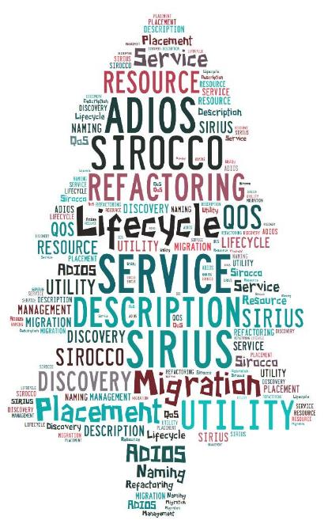
SCIENCE-DRIVEN DATA MANAGEMENT FOR MULTI-TIERED STORAGE February 17, 2016 ECP
S. Klasky ORNL, GT U. Tenn., NCSU
H. Abbasi, Q. Liu, F. Wang ORNL
J. Lofstead, M. Curry, L. Ward Sandia
M. Parashar Rutgers
C. Maltzahn UCSC
M. Ainsworth Brown, ORNL

Slide 2
NOTES
Notes from Sirius dry run
2/9/2015
What is it you are going to do? Must tell them up front in simple terms
ADIOS → Important for the DOE mission
Object storage → order of systems?
Talk about curls and gradients to justify the need to save data
Emphasize that not all potentially useful products can be produced in situ
other types of auditors → compression is really just building a model to reduce the data that must be stored, this work uses understanding of the science to motivate choice of this model.
Challenges→trade offs phrasing
Where do we spend time→Spent most of the time on figures (do you need the bullets? End to end performance is what matters. Complexity makes this an increasingly difficult problem. We need to help the users deal with this complexity
SIRIUS story → Need to tell what we are doing in the project
Abstractions → more time on upper right diagram. No units on right side axis. Kill the pie chart or move to a different slide
[We have a few large high value petabyte scale files that can’t be removed from atlas]
[Working to have a validated database of publications that have emerged from the center. Most cited publications are those in which the user has built a portal to access the data]
Important to enable secondary uses of data!
Jack resistant to promising a slide on this, but will try
Data spaces → main message in title. Simplify words
Data refactoring → need to emphasize that it is not only PIC codes, use another example?
API’s → Lost in the details, what is the message

Slide 3
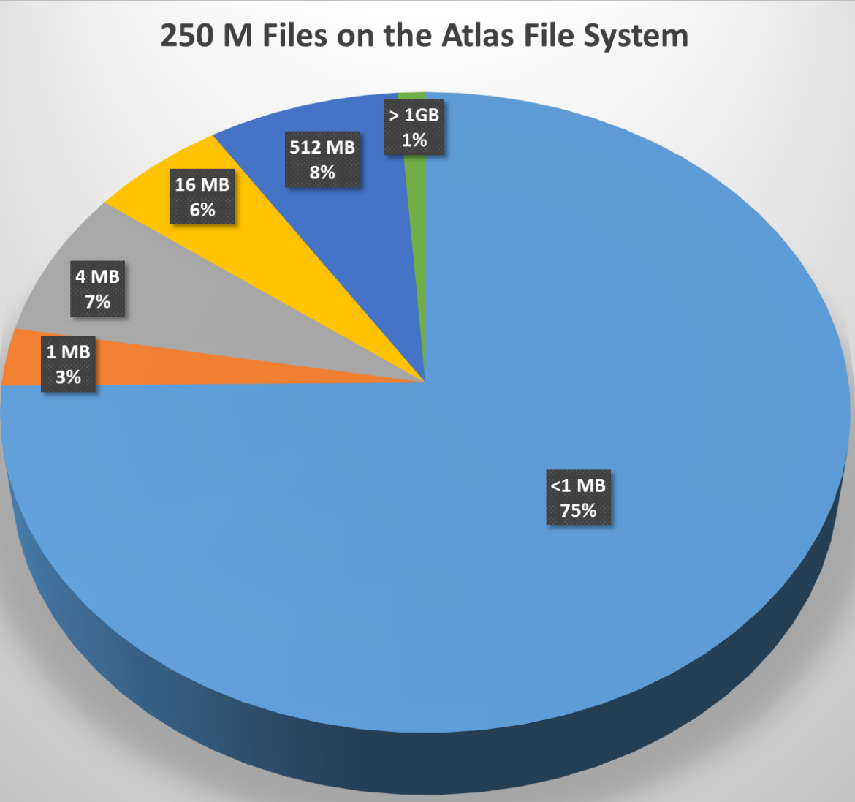
Outline
Motivation
SIRIUS Building Blocks
Data Refactoring
Auditing
Data Description
Metadata Searching
Fuzzy Predictable Performance

Slide 4
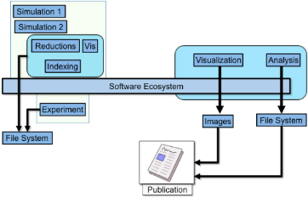
Where Do We Spend Our Time in Science?
Goals
Make the process predictable
Make the process adaptable
Make the process scalable
Make the software easy-to-use
Observation
Too much time is spent in managing, moving, storing, retrieving , and turning the science data into knowledge
Sirius specific Goal
Refactor data so that we can efficiently store, find, retrieve data in predictable times set by the users, negotiated with the system
Notes:
----- Meeting Notes (4/30/13 17:08) -----
step 3: rename Analysis to Analytics to connect back to the trendy buzzword

Slide 5
SIRIUS Story
Exascale Apps will generate too much data
Data needs to be prioritized by the users generating and reading
Data needs to be reduced, re-organized, from large volumes into different buckets of importance
Storage systems may not have the capacity or performance to sustain large datasets
The management of data in multi-tier Storage systems in the data lifecycle will become more difficult to manage
Data access times need to be described by users and negotiated with the storage system for predictable storage performance
Challenges:
How can the middleware and storage system understand refactored data?
How to build scalable metadata searching to find refactored data
The interplay between data refactoring, data re-generation, and data access times

Slide 6
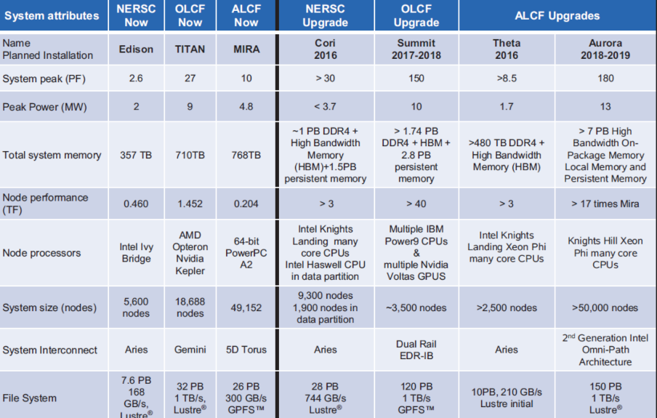
Next Generation DOE computing

Slide 7
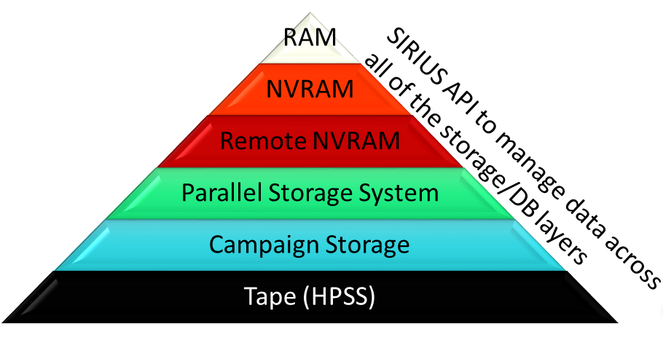

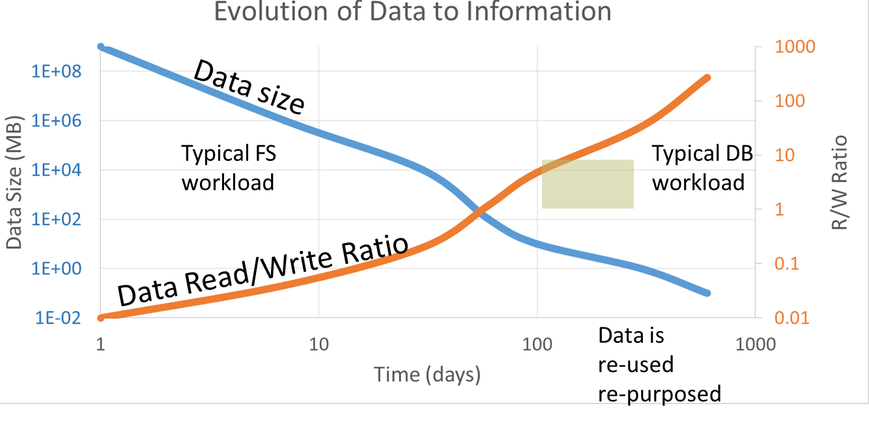
Abstractions across File System to DB

Slide 8
Principles
Principle 1: A knowledge-centric system design that allows user knowledge to define data policies
Today SSIO layers are written in a stove-pipe fashion, and quite often do not allow optimizations to take place
Re-design the layers in a highly integrated fashion where users place their intentions into the system and actions will statically and dynamically take place to optimize for the system and for individual requests
Principle 2: Predictable performance and quality of data in the SSIO layers need to be established so science can be done on the exascale systems in a more efficient manner
Without predictable performance, not only can the runs be slowed down because of contentions on shared resources, but also it affects key science decisions

Slide 9

Outline
Motivation
SIRIUS Building Blocks
Data Refactoring
Auditing
Data Description
Metadata Searching
Fuzzy Predictable Performance

Slide 10
ADIOS – A critical library for DOE apps
Used heavily in many LCF/NERSC applications which we partner with
Allows our team to rapidly prototype new methods and test them for application data lifecycles
Has the ability to describe data utility (XML description)
Allows our team to test out hypothesis
Accelerator: PIConGPU, Warp
Astrophysics: Chimera
Combustion: S3D
CFD: FINE/Turbo, OpenFoam
Fusion: XGC, GTC, GTC-P, M3D,M3D-C1, M3D-K, Pixie3D
Geoscience: SPECFEM3D_GLOBE, AWP-ODC, RTM
Materials Science: QMCPack
Medical: Cancer pathology imaging
Quantum Turbulence: QLG2Q
Visualization: Paraview, Visit, VTK, OpenCV, VTKm
http://www.nccs.gov/user-support/center-projects/adios/

Slide 11
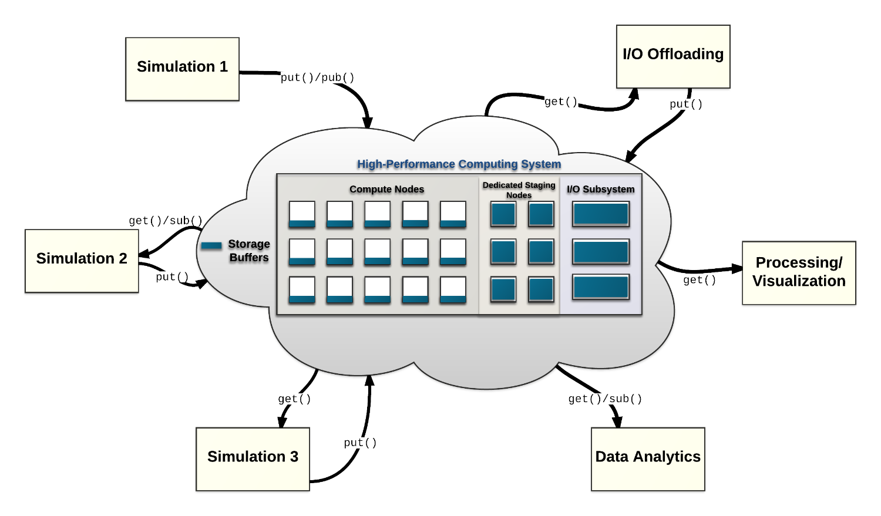
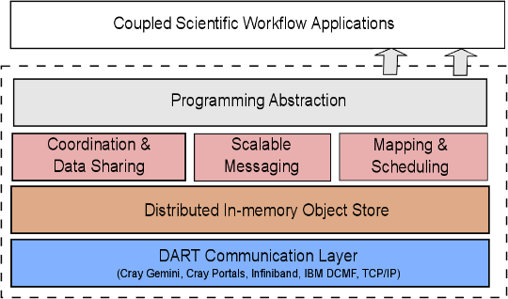
DataSpaces to explore placement strategies on multi-tier memory/storage hierarchies
The DataSpaces Abstraction
Allows our team to stage data across memory and storage hierarchies with different data placement strategies
Building on our “learning” techniques to optimize data placement for different optimization strategies

Slide 12
Object Storage
Light Weight File System-inspired philosophy
Clients bring/opt-in to services they require
Naming, locking, distributed transactions
Peer-to-peer inspired design
Ephemeral, diverse servers and clients
Data and location(s) are decoupled
Addressed systems
Sirocco (Sandia) http://www.cs.sandia.gov/Scalable_IO/sirocco/
Full control from ownership, in development technology
Ceph (RedHat)
Mature, production system with special attention required to address HPC workloads
DAOS (Intel)
Next generation Lustre with strong commercial and DOE support, still under development

Slide 13
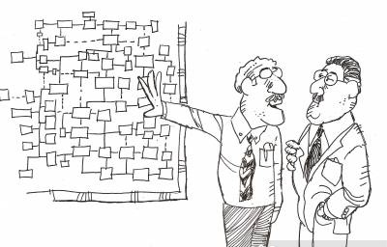
Outline
Motivation
SIRIUS Building Blocks
Data Refactoring
Auditing
Data Description
Metadata Searching
Fuzzy Predictable Performance

Slide 14
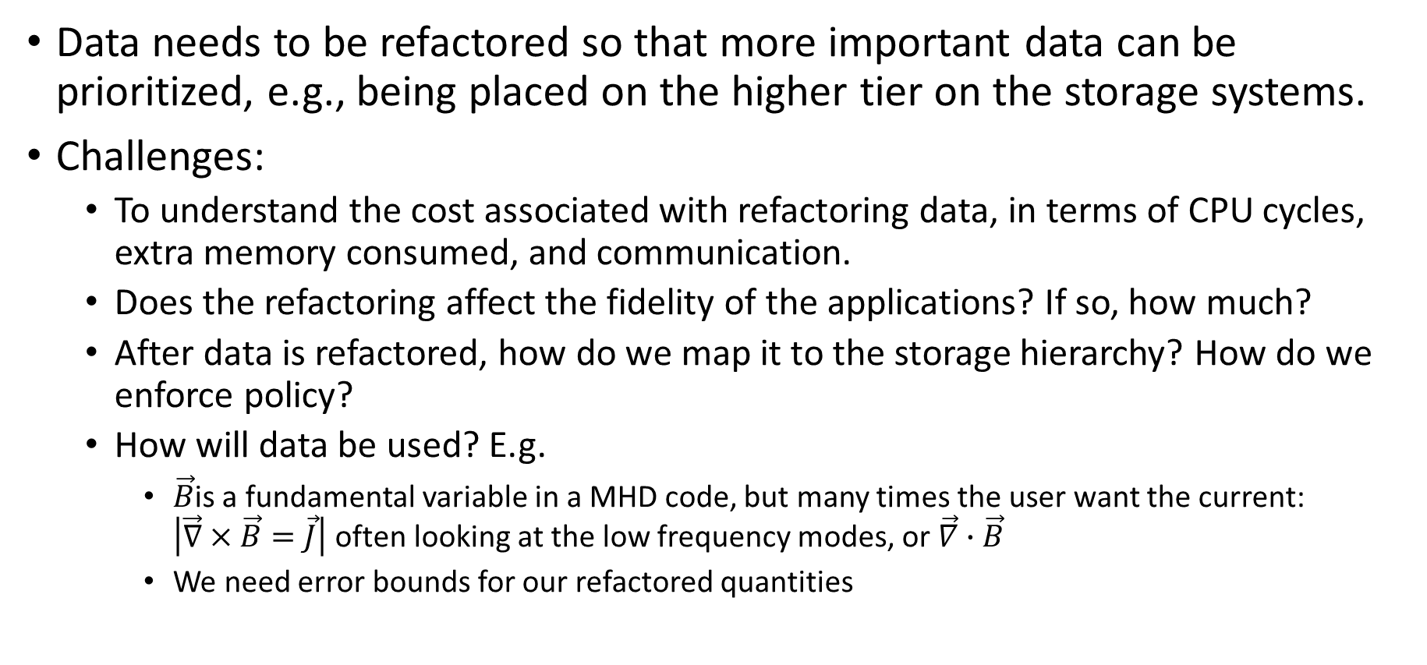
Data Refactoring
Data needs to be refactored so that more important data can be prioritized, e.g., being placed on the higher tier on the storage systems.
Challenges:
To understand the cost associated with refactoring data, in terms of CPU cycles, extra memory consumed, and communication.
Does the refactoring affect the fidelity of the applications? If so, how much?
After data is refactored, how do we map it to the storage hierarchy? How do we enforce policy?
How will data be used? E.g.
$\vec{B}$is a fundamental variable in a MHD code, but many times the user want the current: $\left|\vec{∇}×\vec{B}=\vec{J}\right|$ often looking at the low frequency modes, or $\vec{∇}∙\vec{B}$
We need error bounds for our refactored quantities

Slide 15
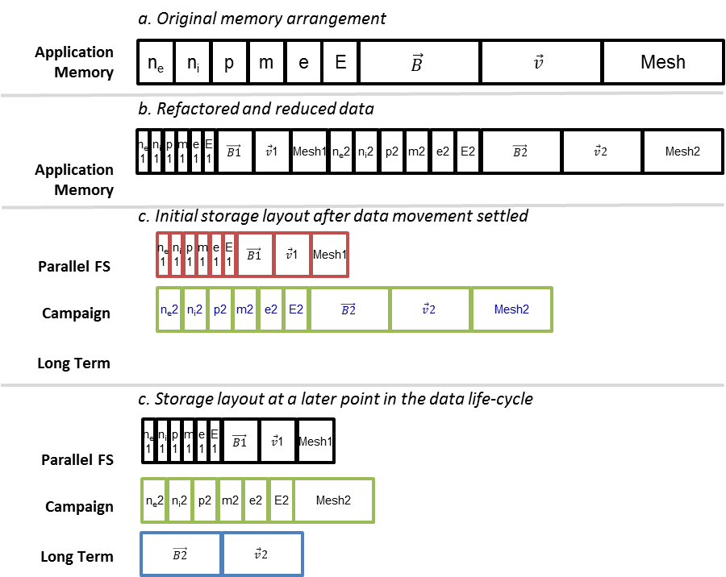
Data Refactoring and Utility Functions
Need to explore what and where the computation will occur
Flexibility in location based on past work
Flexibility in which operation to perform on which chunk of data
Code generation or code containers are potential study targets
Maintaining relationship between data chunks
Carry attributes from generation to consumption and feedback into a utility computation

Slide 16
Data Utility
Describes how long a data chunk will live at a level of the storage hierarchy
Utility is a broad description
Spatial or temporal utility of data
Utility based on in-data features
Utility based on statistical features
Utility has a large component from the user and the use case
Experimental design factors in here
Solving a specific scientific problem => specific data utility function
API for ingesting user preferences and combining with historical provenance
Dynamic utility for online analysis/visualization use cases
e.g. The utility of Mesh may be defined more explicitly as, for example, (priority=1, (time-NVRAM=8 hours, time-PFS=30 days, time-CAMPAIGN=100 days, time-TAPE=1000 days),
(priority=2, (time-NVRAM=1 hours, time-PFS=4 days, time-CAMPAIGN=100 days, time-TAPE=300 days).

Slide 17
Utility-driven Data Placement
Goal: Determine placement of data objects vertically across different levels of the memory hierarchy, e.g., SSD or DRAM, and horizontally at different staging nodes
Utility quantifies the relative value of data objects based on anticipated data read patterns
Utility based on data access patterns (monitored and learnt at runtime) and the location of the application and staging nodes within the system network topology
For example, data objects with higher data utility are placed closer to the computing nodes accessing it
Exploring Data Staging Across Deep Memory Hierarchies for Coupled Data Intensive Simulation Workflows. T. Jin, F. Zhang, Q. Sun, H. Bui, M. Romanus, N. Podhorszki, S. Klasky, H. Kolla, J. Chen, R. Hager, C. Chang, M. Parashar. IEEE IPDPS'15, May 2015
Adaptive Data Placement For Staging-Based Coupled Scientific Workflows. Q. Sun, T. Jin, M. Romanus, H. Bui, F. Zhang, H. Yu, H. Kolla, S. Klasky, J. Chen, M. Parashar. ACM/IEEE SC'15, Nov. 2015.

Slide 18
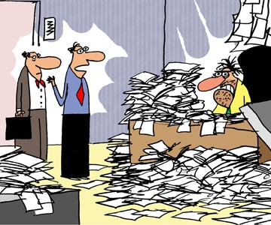
Outline
Motivation
SIRIUS Building Blocks
Data Refactoring
Auditing
Data Description
Metadata Searching
Fuzzy Predictable Performance

Slide 19
New techniques for “Data Intensive Science”
AUDITOR: Creating a reduced model to approximate the solution in a limited spatial/temporal dimenion.
Basic Idea is that we need a model to generate a close approximation of the data
Basic quantities in Information Theory
Data stream S and for x ∈ S let P_{r}(X=x) = p_{x} ∈ [0,1]
Shannon Information Content: h(x) = - log₂ p_{x}
Entropy H(S) = - Σ p_{x} log₂ p_{x}
Noisy/random data has HIGH ENTROPY

Slide 20
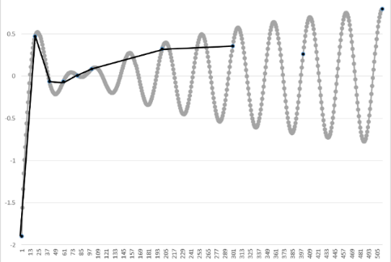
Current practices of today
Linear interpolation
Want to write data every m^{th} timestep
Because of the Storage and I/O requirements users are forced to writing less
If the users reconstruct their data, u(t), at the n^{th} timestep, they need to interpolate between the neighboring timesteps
Φ_{M}(u) = interpolant on coarser grid (stride M), reduce storage my 1/M
Assume (C=constant depending on the complexity of the data)
Original storage cost = 32*N bits (floats)
New storage cost = 32*N/M bits + { 23 – log₂ (C M² Δt²)}N
Ratio = (1/M – 1/16 log₂ M) – 1/16 log₂ Δt + constant
u-ϕ_{M}(u) = O(M² Δt²) : 2nd order interpolation
Cost to store ϕ_{M} + Cost to store mantissa of u- ϕ_{M}(u)
Notes:
8 bits in a byte, 4 bytes per word, N words, M=stride

Slide 21

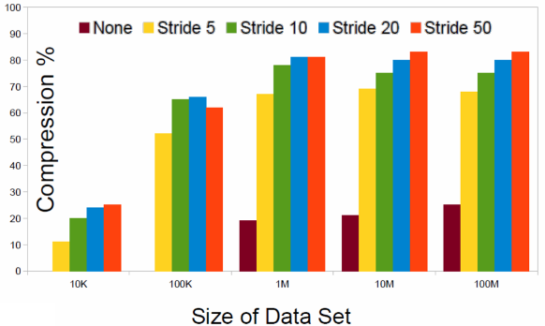
Compression with an interpolation auditor
Linear interpolation (LA) is the auditor
If we look at 10MB output, with a stride of 5
Total output = 50MB for 5 steps
10 MB, if we output 1 step, 43MB “typical lossless compression”, 18MB, using linear auditing but lossless
Investigating adaptive techniques
Stride | 1 step (MB) | lossless compression (MB) | Linear Audit (MB) | Total Data in 50 steps, typical compression | Total data in 50 steps in LA
5 | 10 | 43 | 18 | 430 | 180
10 | 10 | 85 | 25 | 850 | 125
20 | 10 | 170 | 40 | 1700 | 100

Slide 22
Other types of auditors
The key to better auditors is to understand what you are simulating/observing
Use a reduce model
Use less resolution
Use a linear equation for short spatial/temporal regions
And other ways to refactor
Precision based re-organization
Frequency based re-organization - Wavelets
More knowledgeable auditors
Cost of data re-generation vs. data storage/ retrieval
Storage becomes more than a stream of bytes
Data + Code + workflow

Slide 23
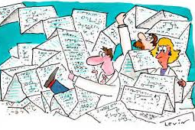
Outline
Motivation
SIRIUS Building Blocks
Data Refactoring
Auditing
Data Description
Metadata Searching
Fuzzy Predictable Performance

Slide 24
Data Descriptions
Now that data is refactored, how do we describe/annotate data so that they can be discovered?
To capture application knowledge and communicate them to middleware/storage
Data utility
Relationships between datasets
Semantics
To specify user requirements
QoS: bandwidth, latency
Policy: E.g., where and how long should my data stay on a storage layer

Slide 25
We are building new APIs into ADIOS
Experiment with new APIs to see if users can program with these and test our hypothesis to see if we can expedite knowledge discovery
How does the system reassemble the pieces after the data has been refactored?
Re-factoring might mean combing different data chunks together, and this takes time!
sirius_init
sirius_finalize
sirius_open -intent
sirus_close -intent
sirius_set_refactor -refactoring_fn
sirius_get_refactor. -refactoring_fn
sirius_sched_write –utility
sirius_sched_read -utility
sirius_set_deadline –deadline, fuzziness
sirius_est_write -time_est, confidence
sirius_est_read -time_est, confidence
sirius_perform_write
sirius_perform_read -deadline, fuzziness

Slide 26

Outline
Motivation
SIRIUS Building Blocks
Data Refactoring
Auditing
Data Description
Metadata Searching
Fuzzy Predictable Performance

Slide 27
Challenges in metadata searching
Storage devices rather than a file system: no built-in metadata operations as part of IO
Distributed pieces EVERYWHERE
Resilience copies
Storage devices come and go
Performance characteristics can vary considerably
Pick a variety of storage targets based on data “importance”
Different data “compression” on different data pieces
Try to “guarantee” performance
Need to consider decompression/regeneration time if multiple versions exist
Enhance placement decision based on predicted future use
Based on tracking previous use (which needs to be tracked somehow)

Slide 28
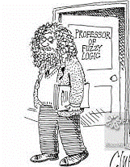
Outline
Motivation
SIRIUS Building Blocks
Data Refactoring
Auditing
Data Description
Metadata Searching
Fuzzy Predictable Performance

Slide 29
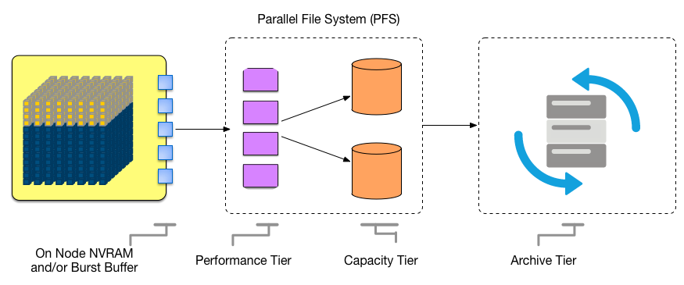
Current day end-to-end path is complex

Slide 30
Autonomic Runtime Optimization
Autonomic Objective (AO):
A requirement/objective/goal defined by the user
E.g. minimize data movement, optimize throughput, etc.
Autonomic Objectives (AO)
Decide
Autonomic Policy (AP)
A rule that defines how the objectives should be achieved, i.e., which mechanisms should be used
E.g. use a specific data placement adaptation to minimize data movement , etc.
Autonomic Policies (AP)
Achieve
Autonomic Mechanism (AM)
An action that can be used to achieve an AO
E.g. use topology-aware and access-pattern driven data placement to minimize data movement, etc.
Specify/Utilize
Autonomic Mechanisms (AM)

Slide 31
Challenges
Scalable admission control
Need scalable control plane (leverage existing work on causal metadata propagation and online sampling for latency/error trade-offs)
Resource-specific schedulers to make performance of resource predictable
Example: read/write separation at flash devices
Online sampling to provide quick latency/resolution trade-offs
Without significantly interfering with ongoing workload

Slide 32
Current Status
SIRIUS will be open source since the beginning of the project
SIRIUS users:
DOE Fusion XGC1, GTC, and etc, as initial users to drive the development
Long term support of SIRIUS will leverage various funding sources include DOE SSIO, DOE SciDAC, OLCF, and etc.
SIRIUS is driven by the fact that many DOE applications generates large amounts of analysis data that need to be mapped to storage hierarchy efficiently.

Slide 33
Current Status
To ensure that SIRIUS will be ready for exascale software stack, we will identify and resolve major research challenges in the next 3 years, and leverage ECP as well as other future projects (e.g., SciDAC, LCF), and work closely with applications to harden the software.
SIRIUS will build upon key capabilities that were/have been funded by ASCR.
Include ADIOS, DataSpaces, Sirocco and DAOS
SIRIUS will further build upon these successes and further integration and advance data storage and analysis capabilities.

Slide 34
Summary
Sirius is attempting to redefine I/O based on key findings
POSIX-compliant block interface does not give the system enough information to fully optimize
Data is too big to keep in one place and current systems purge data without user intervention
Variability is too large, and users are not in control of their data
Scientific Data is not random data
There is content to the data
Auditing calculations to prioritize, reduce data sizes but keep the information is critical to reduce the time of understanding

Slide 35

Questions

